Slide 1
Battle of Neighborhood
Prediction Related to Restaurants

Slide 2
Introduction
The buildings, population, various restaurants, transportation, various shops, various cuisines, demographics, environments and culture are different from one another.
Analyzation of the cuisine around the neighborhoods of city in order to determine that how popular those restaurants are.
Compared in respect to the place where they can eat, live and how diverse are both the places.
Will be considered taking environments, restaurants, ratings, people reviews/tips about the place and dishes while comparing.
The target audience will the food consumers who prefers particular cusine more.

Slide 3
Data Section
This section deal with the primary data set which we will be using in the project.
1. The data which we will using for the project is that New York Data Set. Both the data sets consists of 3 columns which we will be using they are:
  Locations
  Neighborhoods
  Latitudes
  Longitudes
  Boroughs

Slide 4
Data Section (Countinue)
Foursquare API will be used for the analyzation phrase. It is used to analyze the nearby restaurants & cuisines of the neighborhoods and calculate the frequency of people been to these places in order to see how popular and important these places are.
Data will be well sorted and cleaned for the processing and methodology phrase.
Following is the link of the dataset which we will be using in this project: https://cocl.us/new_york_dataset.

Slide 5
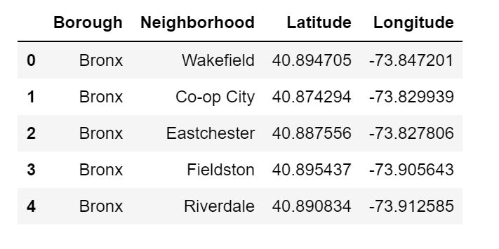
Data Frame
We first got our New York data frame with the Borough, Neighborhood, Corresponding Latitude and Longitude. Following is the screenshot of our data frame New York
This Data frame consist of data that we need to pursue with.

Slide 6
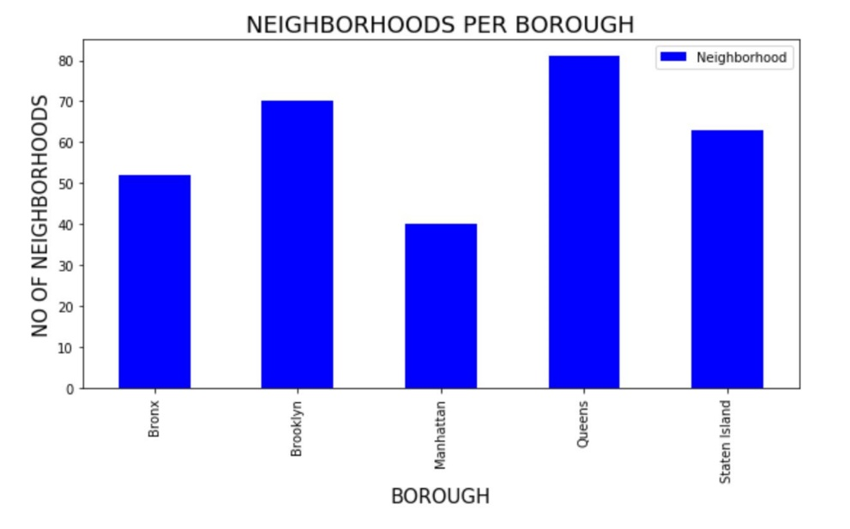
Data Analyzations
Following we have created the bar plot inorder to analyze the insights from our input data.
As we can see above graph that, the place "Queens" in New York has the most number of neighborhoods, on the other hand "Manhattan" has comparatively less number of neighborhoods.

Slide 7
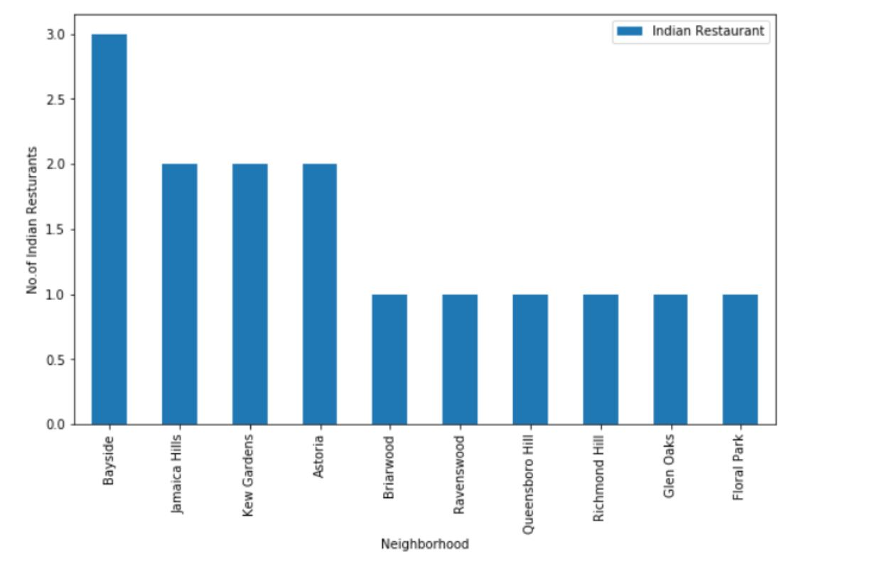
Analyzing Cuisines
After analyzing the data, I got to know that Bayside has the highest indian cuisines than any other areas in NY.

Slide 8
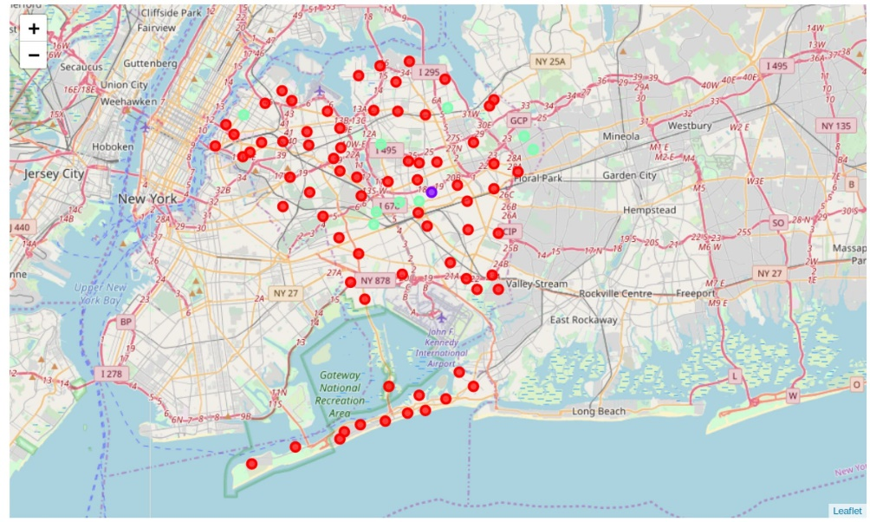
Folium Map
Following is the folium map of result set.

Slide 9
Conclusion
After analyzing all the way down we came to a conclusion that new York is a good place to eat Indian cuisines.
More accurately Brooklyn is the best place to have Indian cuisines as this place consist of more number of Indian cuisines and also with good ratings.
Many good ratings which are above 8.0 rating are situated majorly in Brooklyn.
Secondly Manhattan is also a good place to eat Indian cuisines as this place also have certain very good Indian restaurants.

